Slide 1
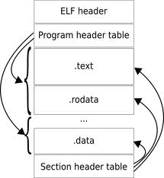
EECS 373
Design of Microprocessor-Based Systems
Prabal Dutta
University of Michigan
Lecture 3: ISA, Assembly, and Toolchains
September 13, 2011

Slide 2
Announcements
Make sure you get the latest labs online
  We’ll fix bugs as they’re found
  If something doesn’t work, make sure you have a fresh copy
Prabal’s office hours
  Tuesday, 9/13
  1:30 PM to 3:00 PM
  4773 CSE

Slide 3
Outline
Minute quiz
Announcements
ARM Cortex-M3 ISA
Assembly tool flow
C/Assembly mixed tool flow

Slide 4
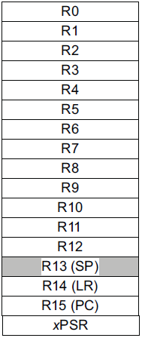
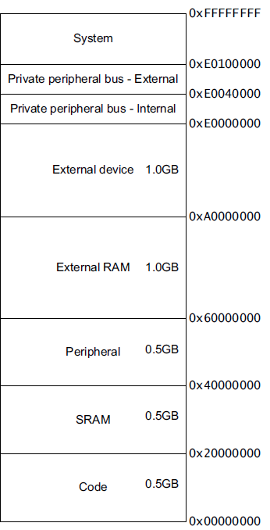
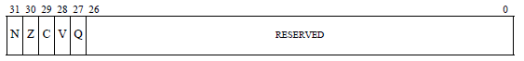
Major elements of an Instruction Set Architecture
(registers, memory, word size, endianess, conditions, instructions, addressing modes)
32-bits
32-bits
mov r0, #1
ld r1, [r0,#5]
mem((r0)+5)
bne loop
subs r2, #1
Endianess
Endianess

Slide 5
Instruction classes
Branching
Data processing
Load/store
Exceptions
Miscellaneous
Notes:
Condition codes are simply a way of testing the ALU status flags.

Slide 6
Addressing Modes
Offset Addressing
  Offset is added or subtracted from base register
  Result used as effective address for memory access
  [<Rn>, <offset>]
Pre-indexed Addressing
  Offset is applied to base register
  Result used as effective address for memory access
  Result written back into base register
  [<Rn>, <offset>]!
Post-indexed Addressing
  The address from the base register is used as the EA
  The offset is applied to the base and then written back
  [<Rn>], <offset>
Notes:
Condition codes are simply a way of testing the ALU status flags.

Slide 7
<offset> options
An immediate constant
  #10
An index register
  <Rm>
A shifted index register
  <Rm>, LSL #<shift>
Notes:
Condition codes are simply a way of testing the ALU status flags.

Slide 8
Updating the Application Program Status Register
(aka condition codes or APRS)
sub r0, r1
  r0 ← r0 – r1
  APSR remain unchanged
subs r0, r1
  r0 ← r0 – r1
  APSR N or Z bits could change
add r0, r1
  r0 ← r0 + r1
  APSR remain unchanged
adds r0, r1
  r0 ← r0 + r1
  APSR C or V bits could change
Notes:
Condition codes are simply a way of testing the ALU status flags.

Slide 9
What does some real assembly look like?
0000017c <main>:
17c: b580 push {r7, lr}
17e: b084 sub sp, #16
180: af00 add r7, sp, #0
182: f04f 0328 mov.w r3, #40 ; 0x28
186: 60bb str r3, [r7, #8]
188: f04f 0300 mov.w r3, #0
18c: 60fb str r3, [r7, #12]
18e: f04f 0300 mov.w r3, #0
192: 603b str r3, [r7, #0]
194: e010 b.n 1b8 <main+0x3c>
196: 6838 ldr r0, [r7, #0]
198: f7ff ffb8 bl 10c <factorial>
19c: 4603 mov r3, r0
19e: 607b str r3, [r7, #4]
1a0: f646 5010 movw r0, #27920 ; 0x6d10
1a4: f2c0 0000 movt r0, #0
1a8: 6839 ldr r1, [r7, #0]
1aa: 687a ldr r2, [r7, #4]
1ac: f000 f840 bl 230 <printf>
1b0: 683b ldr r3, [r7, #0]
...

Slide 10

The endianess religious war: 284 years and counting!
Modern version
  Danny Cohen
  IEEE Computer, v14, #10
  Published in 1981
  Satire on CS religious war
Historical Inspiration
  Jonathan Swift
  Gullivers Travels
  Published in 1726
  Satire on Henry-VIII’s split with the Church
Little-Endian
  LSB is at lower address
Memory Value
Offset (LSB) (MSB)
====== ===========
uint8_t a = 1; 0x0000 01 02 FF 00
uint8_t b = 2;
uint16_t c = 255; // 0x00FF
uint32_t d = 0x12345678; 0x0004 78 56 34 12
Big-Endian
  MSB is at lower address
Memory Value
Offset (LSB) (MSB)
====== ===========
uint8_t a = 1; 0x0000 01 02 00 FF
uint8_t b = 2;
uint16_t c = 255; // 0x00FF
uint32_t d = 0x12345678; 0x0004 12 34 56 78

Slide 11
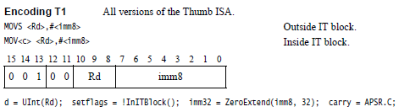
Instruction encoding
Instructions are encoded in machine language opcodes
Sometimes
  Necessary to hand generate opcodes
  Necessary to verify assembled code is correct
How?
Instructions
movs r0, #10
movs r1, #0
Register Value Memory Value
001|00|000|00001010 (LSB) (MSB)
(msb) (lsb) 0a 20 00 21
001|00|001|00000000
ARMv7 ARM
Notes:
Condition codes are simply a way of testing the ALU status flags.

Slide 12
What happens after a power-on-reset (POR)?
On the ARM Cortex-M3
SP and PC are loaded from the code (.text) segment
Initial stack pointer
  LOC: 0x00000000
  POR: SP ← mem(0x00000000)
Interrupt vector table
  Initial base: 0x00000004
  Vector table is relocatable
  Entries: 32-bit values
  Each entry is an address
  Entry #1: reset vector
    LOC: 0x0000004
    POR: PC ← mem(0x00000004)
Execution begins
.equ STACK_TOP, 0x20000800
.text
.syntax unified
.thumb
.global _start
.type start, %function
_start:
.word STACK_TOP, start
start:
movs r0, #10
...

Slide 13
Outline
Minute quiz
Announcements
ARM Cortex-M3 ISA
Assembly tool flow
C/Assembly mixed tool flow

Slide 14
How does an assembly language program get turned into a executable program image?
Binary program
file (.bin)
Assembly
files (.s)
Object
files (.o)
Executable
image file
objcopy
ld
(linker)
as
(assembler)
objdump
Memory
layout
Disassembled
code (.lst)
Linker
script (.ld)

Slide 15
What are the real GNU executable names for the ARM?
Just add the prefix “arm-none-eabi-” prefix
Assembler (as)
  arm-none-eabi-as
Linker (ld)
  arm-none-eabi-ld
Object copy (objcopy)
  arm-none-eabi-objcopy
Object dump (objdump)
  arm-none-eabi-objdump
C Compiler (gcc)
  arm-none-eabi-gcc
C++ Compiler (g++)
  arm-none-eabi-g++

Slide 16
A simple (hardcoded) Makefile example
all:
arm-none-eabi-as -mcpu=cortex-m3 -mthumb example1.s -o example1.o
arm-none-eabi-ld -Ttext 0x0 -o example1.out example1.o
arm-none-eabi-objcopy -Obinary example1.out example1.bin
arm-none-eabi-objdump -S example1.out > example1.lst

Slide 17
What information does the disassembled file provide?
all:
arm-none-eabi-as -mcpu=cortex-m3 -mthumb example1.s -o example1.o
arm-none-eabi-ld -Ttext 0x0 -o example1.out example1.o
arm-none-eabi-objcopy -Obinary example1.out example1.bin
arm-none-eabi-objdump -S example1.out > example1.lst
.equ STACK_TOP, 0x20000800
.text
.syntax unified
.thumb
.global _start
.type start, %function
_start:
.word STACK_TOP, start
start:
movs r0, #10
movs r1, #0
loop:
adds r1, r0
subs r0, #1
bne loop
deadloop:
b deadloop
.end
example1.out: file format elf32-littlearm
Disassembly of section .text:
00000000 <_start>:
0: 20000800 .word 0x20000800
4: 00000009 .word 0x00000009
00000008 <start>:
8: 200a movs r0, #10
a: 2100 movs r1, #0
0000000c <loop>:
c: 1809 adds r1, r1, r0
e: 3801 subs r0, #1
10: d1fc bne.n c <loop>
00000012 <deadloop>:
12: e7fe b.n 12 <deadloop>

Slide 18
What are the elements of a real assembly program?
.equ STACK_TOP, 0x20000800 /* Equates symbol to value */
.text /* Tells AS to assemble region */
.syntax unified /* Means language is ARM UAL */
.thumb /* Means ARM ISA is Thumb */
.global _start /* .global exposes symbol */
/* _start label is the beginning */
/* ...of the program region */
.type start, %function /* Specifies start is a function */
/* start label is reset handler */
_start:
.word STACK_TOP, start /* Inserts word 0x20000800 */
/* Inserts word (start) */
start:
movs r0, #10 /* We’ve seen the rest ... */
movs r1, #0
loop:
adds r1, r0
subs r0, #1
bne loop
deadloop:
b deadloop
.end

Slide 19
How are assembly files assembled?
$ arm-none-eabi-as
  Useful options
    -mcpu
    -mthumb
    -o
$ arm-none-eabi-as -mcpu=cortex-m3 -mthumb example1.s -o example1.o

Slide 20
How can the contents of an object file be read?
$ readelf –a example.o
Shows
  ELF headers
  Program headers
  Section headers
  Symbol table
  Files attributes
Other options
  -s shows symbols
  -S shows section headers

Slide 21
What does an object file contain?
$ readelf -S example1.o
There are 9 section headers, starting at offset 0xac:
Section Headers:
[Nr] Name Type Addr Off Size ES Flg Lk Inf Al
[ 0] NULL 00000000 000000 000000 00 0 0 0
[ 1] .text PROGBITS 00000000 000034 000014 00 AX 0 0 1
[ 2] .rel.text REL 00000000 000300 000008 08 7 1 4
[ 3] .data PROGBITS 00000000 000048 000000 00 WA 0 0 1
[ 4] .bss NOBITS 00000000 000048 000000 00 WA 0 0 1
[ 5] .ARM.attributes ARM_ATTRIBUTES 00000000 000048 000021 00 0 0 1
[ 6] .shstrtab STRTAB 00000000 000069 000040 00 0 0 1
[ 7] .symtab SYMTAB 00000000 000214 0000c0 10 8 11 4
[ 8] .strtab STRTAB 00000000 0002d4 00002c 00 0 0 1
Key to Flags:
W (write), A (alloc), X (execute), M (merge), S (strings)
I (info), L (link order), G (group), x (unknown)
O (extra OS processing required) o (OS specific), p (processor specific)

Slide 22
How are object files linked?
$ arm-none-eabi-ld
  Useful options
    -Ttext
    -Tbss
    -o
$ arm-none-eabi-ld -Ttext 0x0 –Tbss 0x20000000 -o example1.out example1.o

Slide 23
What are the contents of typical linker script?
OUTPUT_FORMAT("elf32-littlearm", "elf32-bigarm", "elf32-littlearm")
OUTPUT_ARCH(arm)
ENTRY(main)
MEMORY
{
ram (rwx) : ORIGIN = 0x20000000, LENGTH = 64k
}
SECTIONS
{
.text :
{
. = ALIGN(4);
*(.text*)
. = ALIGN(4);
_etext = .;
} >ram
}
end = .;

Slide 24
What does an executable image file contain?
.text segment
  Executable code
  Initial reset vector
.data segment (.rodata in ELF)
  Static (initialized) variables
.bss segment
  Static (uninitialized) variables
  Zero-filled by CRT or OS
  From: Block Started by Symbol
Does not contain heap or stack
For details, see:
  /usr/include/linux/elf.h

Slide 25
How can the contents of an executable file be read?
Exactly the same way as an object file!
Recall the useful options
  -a show all information
  -s shows symbols
  -S shows section headers

Slide 26
What does an executable file contain?
Use readelf’s –S option
Note that the .out has fewer sections than the .o file
  Why?
$ readelf -S example1.out
There are 6 section headers, starting at offset 0x8068:
Section Headers:
[Nr] Name Type Addr Off Size ES Flg Lk Inf Al
[ 0] NULL 00000000 000000 000000 00 0 0 0
[ 1] .text PROGBITS 00000000 008000 000014 00 AX 0 0 4
[ 2] .ARM.attributes ARM_ATTRIBUTES 00000000 008014 000021 00 0 0 1
[ 3] .shstrtab STRTAB 00000000 008035 000031 00 0 0 1
[ 4] .symtab SYMTAB 00000000 008158 000130 10 5 9 4
[ 5] .strtab STRTAB 00000000 008288 000085 00 0 0 1
Key to Flags:
W (write), A (alloc), X (execute), M (merge), S (strings)
I (info), L (link order), G (group), x (unknown)
O (extra OS processing required) o (OS specific), p (processor specific)

Slide 27
What are the contents of an executable’s .text segment?
Use readelf’s –x option to hex dump a section
1st column shows memory address
2nd through 5th columns show data
The initial SP and PC values are visible
The executable opcodes are also visible
$ readelf -x .text example1.out
Hex dump of section '.text':
0x00000000 | 00080020 09000000 0a200021 09180138 ... ..... .!...8
0x00000010 | fcd1fee7 ....

Slide 28
What are the raw contents of an executable file?
Use hexdump
ELF’s magic number is visible
The initial SP, PC, executable opcodes are visible
$ hexdump example1.out
0000000 457f 464c 0101 0001 0000 0000 0000 0000
0000010 0002 0028 0001 0000 0000 0000 0034 0000
0000020 8068 0000 0000 0500 0034 0020 0001 0028
0000030 0006 0003 0001 0000 8000 0000 0000 0000
0000040 0000 0000 0014 0000 0014 0000 0005 0000
0000050 8000 0000 0000 0000 0000 0000 0000 0000
0000060 0000 0000 0000 0000 0000 0000 0000 0000
*
0008000 0800 2000 0009 0000 200a 2100 1809 3801
0008010 d1fc e7fe 2041 0000 6100 6165 6962 0100
0008020 0016 0000 4305 524f 4554 2d58 334d 0600
0008030 070a 094d 0002 732e 6d79 6174 0062 732e
0008040 7274 6174 0062 732e 7368 7274 6174 0062
0008050 742e 7865 0074 412e 4d52 612e 7474 6972
0008060 7562 6574 0073 0000 0000 0000 0000 0000
0008070 0000 0000 0000 0000 0000 0000 0000 0000
*
0008090 001b 0000 0001 0000 0006 0000 0000 0000

Slide 29
What purpose does an executable file serve?
Serves as a convenient container for sections/segments
Keeps segments segregate by type and access rights
Serves as a program “image” for operating systems
Allows the loader to place segments into main memory
Can integrates symbol table and debugging information

Slide 30
How useful is an executable image
for most embedded systems & tools?

Slide 31
What does a binary program image contain?
Basically, a binary copy of program’s .text section
Try ‘hexdump –C example.bin’
Want to change the program?
  Try ‘hexedit example.bin’
  You can change the program (e.g. opcodes, static data, etc.)
The initial SP, PC, executable opcodes are visible
$ hexdump -C example.bin
00000000 00 08 00 20 09 00 00 00 0a 20 00 21 09 18 01 38 |....|
00000010 fc d1 fe e7 |....|
00000014
$ hexedit example.bin
00000000 00 08 00 20 09 00 00 00 0A 20 00 21 09 18 01 38 ....
00000010 FC D1 FE E7 ....

Slide 32
What are other, more usable formats?
.o, .out, and .bin are all binary formats
Many embedded tools don’t use binary formats
Two common ASCII formats
  Intel hex (ihex)
  Motorola S-records (srec)
The initial SP, PC, executable opcodes are visible
$ arm-none-eabi-objcopy -O ihex example1.out "example1.hex“
$ cat example1.hex
:1000000000080020090000000A200021091801381A
:04001000FCD1FEE73A
:00000001FF
$ arm-none-eabi-objcopy -O srec example1.out "example1.srec“
$ cat example1.srec
S01000006578616D706C65312E73726563F7
S113000000080020090000000A2000210918013816
S1070010FCD1FEE736
S9030000FC

Slide 33
Outline
Minute quiz
Announcements
ARM Cortex-M3 ISA
Assembly tool flow
C/Assembly mixed tool flow

Slide 34
How does a mixed C/Assembly program get turned into a executable program image?
C files (.c)
Binary program
file (.bin)
ld
(linker)
Assembly
files (.s)
Object
files (.o)
Executable
image file
objcopy
gcc
(compile
+ link)
as
(assembler)
objdump
Memory
layout
Disassembled
Code (.lst)
Library object
files (.o)
Linker
script (.ld)

Slide 35
Cheap trick: use asm() or __asm() macros to sprinkle simple assembly in standard C code!
int main() {
int i;
int n;
unsigned int input = 40, output = 0;
for (i = 0; i < 10; ++i) {
n = factorial(i);
printf("factorial(%d) = %d\n", i, n);
}
__asm("nop\n");
__asm("mov r0, %0\n"
"mov r3, #5\n"
"udiv r0, r0, r3\n"
"mov %1, r0\n"
:"=r" (output)
: "r" (input)
: "cc", "r3" );
__asm("nop\n");
printf("%d\n", output);
}
$ arm-none-eabi-gcc \
-mcpu=cortex-m3 \
-mthumb main.c \
-T generic-hosted.ld \
-o factorial
$ qemu-arm -cpu cortex-m3 \
./factorial
factorial(0) = 1
factorial(1) = 1
factorial(2) = 2
factorial(3) = 6
factorial(4) = 24
factorial(5) = 120
factorial(6) = 720
factorial(7) = 5040
factorial(8) = 40320
factorial(9) = 362880
8
Answer: 40/5 →

Slide 36
Questions?
Comments?
Discussion?

Slide 37
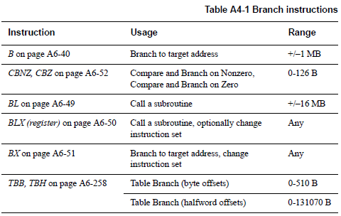
Branch

Slide 38
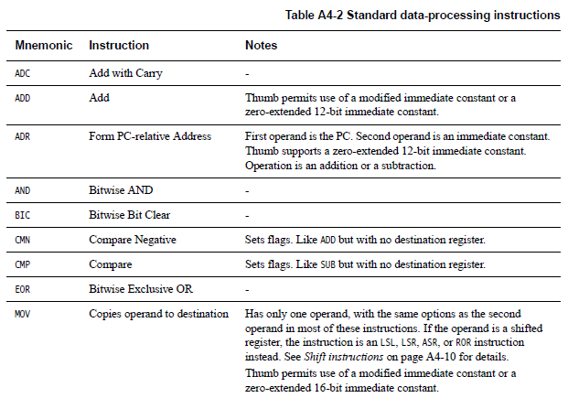
Data processing instructions
Many, Many More!

Slide 39
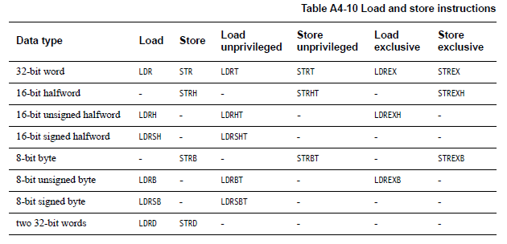
Load/Store instructions

Slide 40
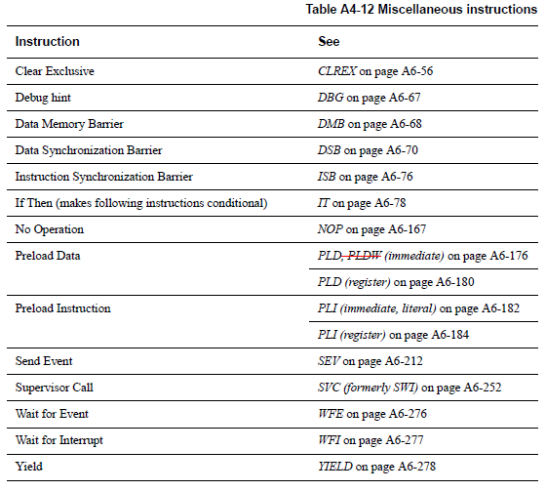
Miscellaneous instructions

Slide 41
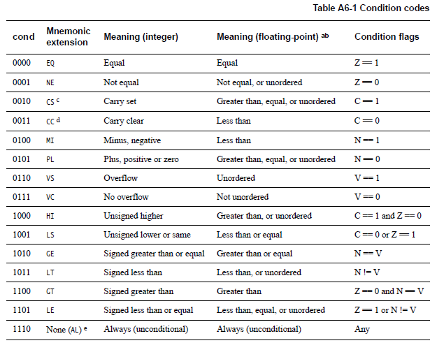
Conditional execution:
Append to many instructions for conditional execution
Notes:
Condition codes are simply a way of testing the ALU status flags.

